Slide 1
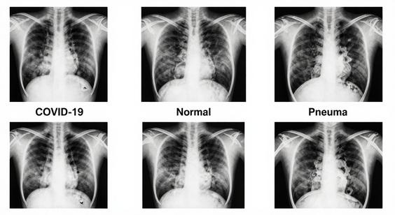
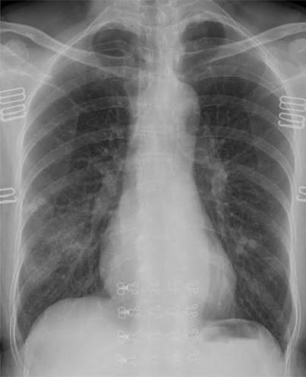
COVID-19 Detection from Chest X-Ray Images Using CNN and VGG16
Name : S. Hasini
Roll No:2520030287
Name : S. Vaibhava Sree
Roll No:2520030398

Slide 2
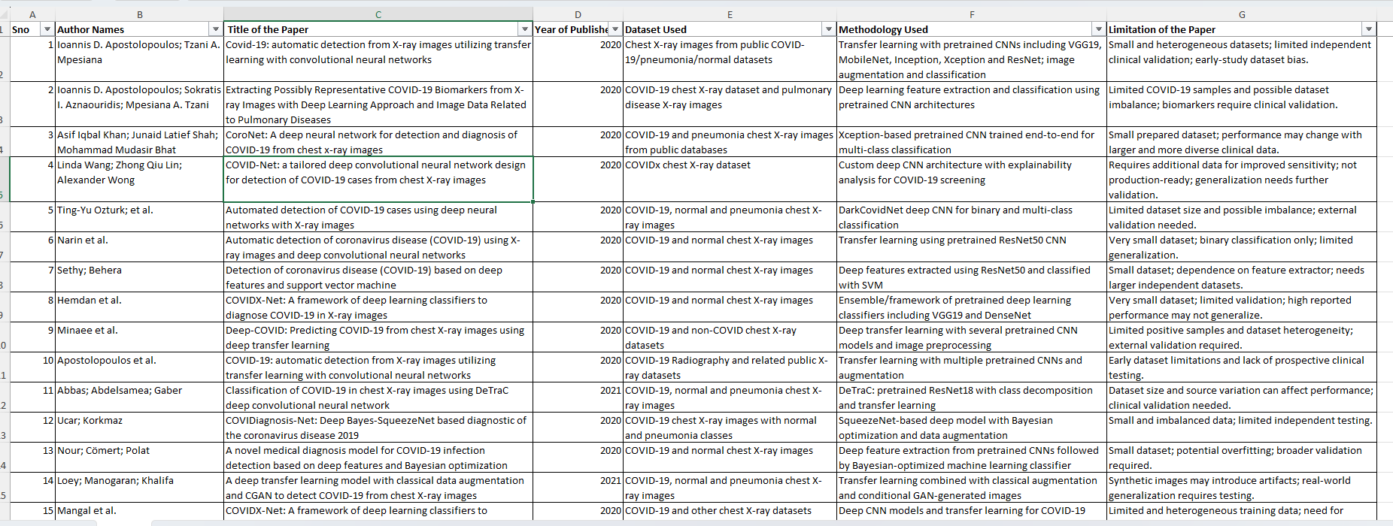
Literature Survey:

Slide 3
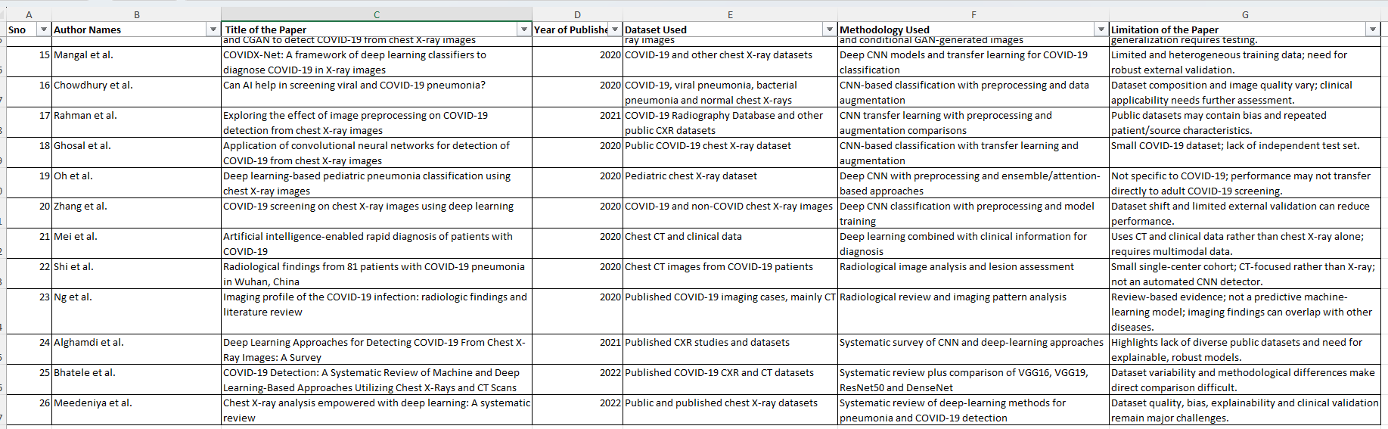

Slide 4
Introduction:
COVID-19 is a global pandemic affecting millions worldwide.
Early detection is critical to reduce spread and improve treatment outcomes.
RT-PCR tests are accurate but slow, costly, and limited in availability.
Chest X-rays are widely available, fast, and cost-effective diagnostic tools.
Manual diagnosis can be time-consuming and prone to human error.
Deep Learning enables automated detection of disease patterns.
CNNs are powerful for medical image classification tasks.
Transfer Learning (VGG16) reduces training time and improves efficiency.
Goal :Build a reliable AI system to assist doctors in rapid COVID-19 screening.

Slide 5
Problem Statement & objectives
Problem Statement: Develop an automated deep learning system that can detect COVID-19 from chest X-ray images accurately, efficiently, and with minimal human intervention.
Objectives:
Automate detection of COVID-19 cases from chest X-ray images.
Classify images into three categories: COVID-19, Pneumonia, and Normal.
Reduce dependency on manual diagnosis and expert radiologists.
Use VGG16 transfer learning to minimize training time and computational cost.
Achieve high accuracy, precision, recall, and F1-score for reliable performance.
Provide a supportive tool for doctors and healthcare professionals.
Enable faster preliminary screening in hospitals and clinics.
Improve scalability for large datasets and real-world deployment.
Lay the foundation for mobile/web applications for real-time detection

Slide 6
Datasets:
Sources: COVIDx dataset, Kaggle chest X-ray dataset, NIH dataset.
Classes: Three categories – COVID-19, Pneumonia, Normal.
Size: Thousands of labelled chest X-ray images collected from multiple hospitals.
Features: Lung opacity, lesions, infiltrates, abnormal textures, and structural changes.
Diversity: Images from different patients, age groups, and genders.
Preprocessing: Images resized to 224×224 pixels for VGG16 input.
Normalization: Pixel values scaled to improve training stability.
Augmentation: Rotation, flipping, zooming, brightness adjustment to balance dataset.
Split: Training(70%), validation(15%), and test (15%) sets created for robust evaluation.

Slide 7
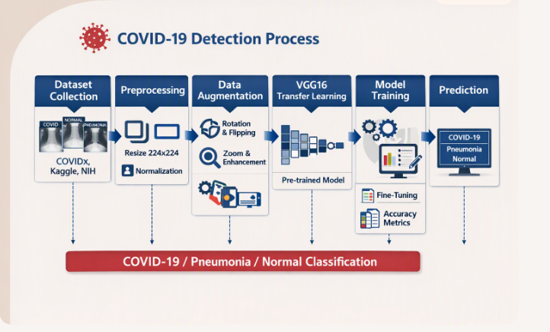
Proposed Methodology
Dataset Collection
⬇️
Image Preprocessing (Resize 224×224, Normalize)
⬇️
Data Augmentation (Rotation, Flip, Zoom)
⬇️
Transfer Learning (VGG16 Pre‑trained Model)
⬇️
Feature Extraction (Convolution Layers)
⬇️
Model Training (Fine‑tuning, Adam Optimizer)
⬇️
Model Evaluation (Accuracy, Precision, Recall, F1‑Score)
⬇️
Prediction (COVID‑19 / Pneumonia / Normal)

Slide 8
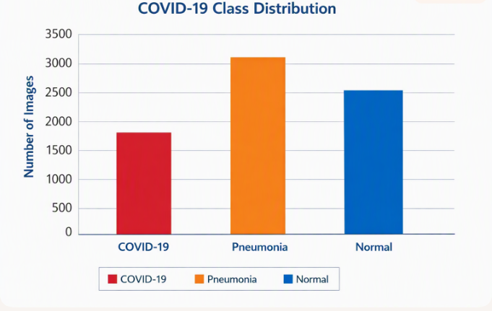
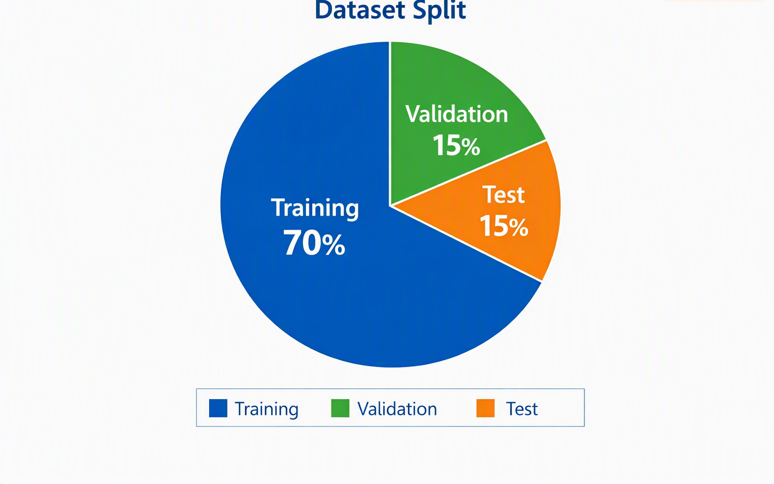
EDA
Class Distribution Bar Chart
  X‑axis: Classes (COVID‑19, Pneumonia, Normal)
  Y‑axis: Number of images
  Shows dataset imbalance (if any).
Pie Chart of Dataset Split
  Training vs Validation vs Test percentages.
  Clear visual of how data is divided.
Sample Chest X‑Ray Images
  One example each: COVID‑19, Pneumonia, Normal.
  Helps audience see differences in lung opacity.
Histogram of Pixel Intensity
  Distribution of grayscale values.
  Shows preprocessing need (normalization).
Augmentation Examples
  Original image vs rotated/flipped/zoomed versions.
  Demonstrates how dataset diversity is increased.
Heatmap (Optional)
  Correlation between features (if extracted).
  Adds depth to your analysis.

Slide 9
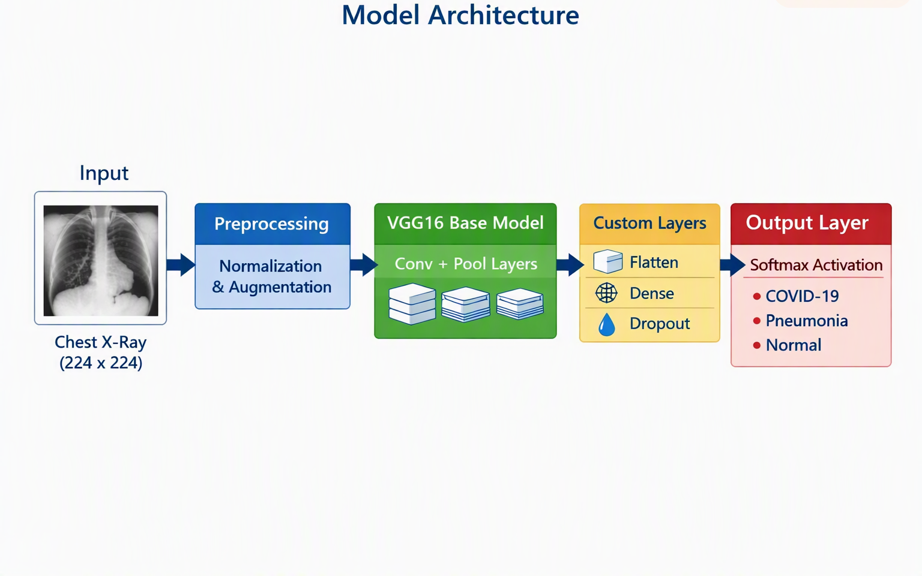
Model Architecture:

Slide 10
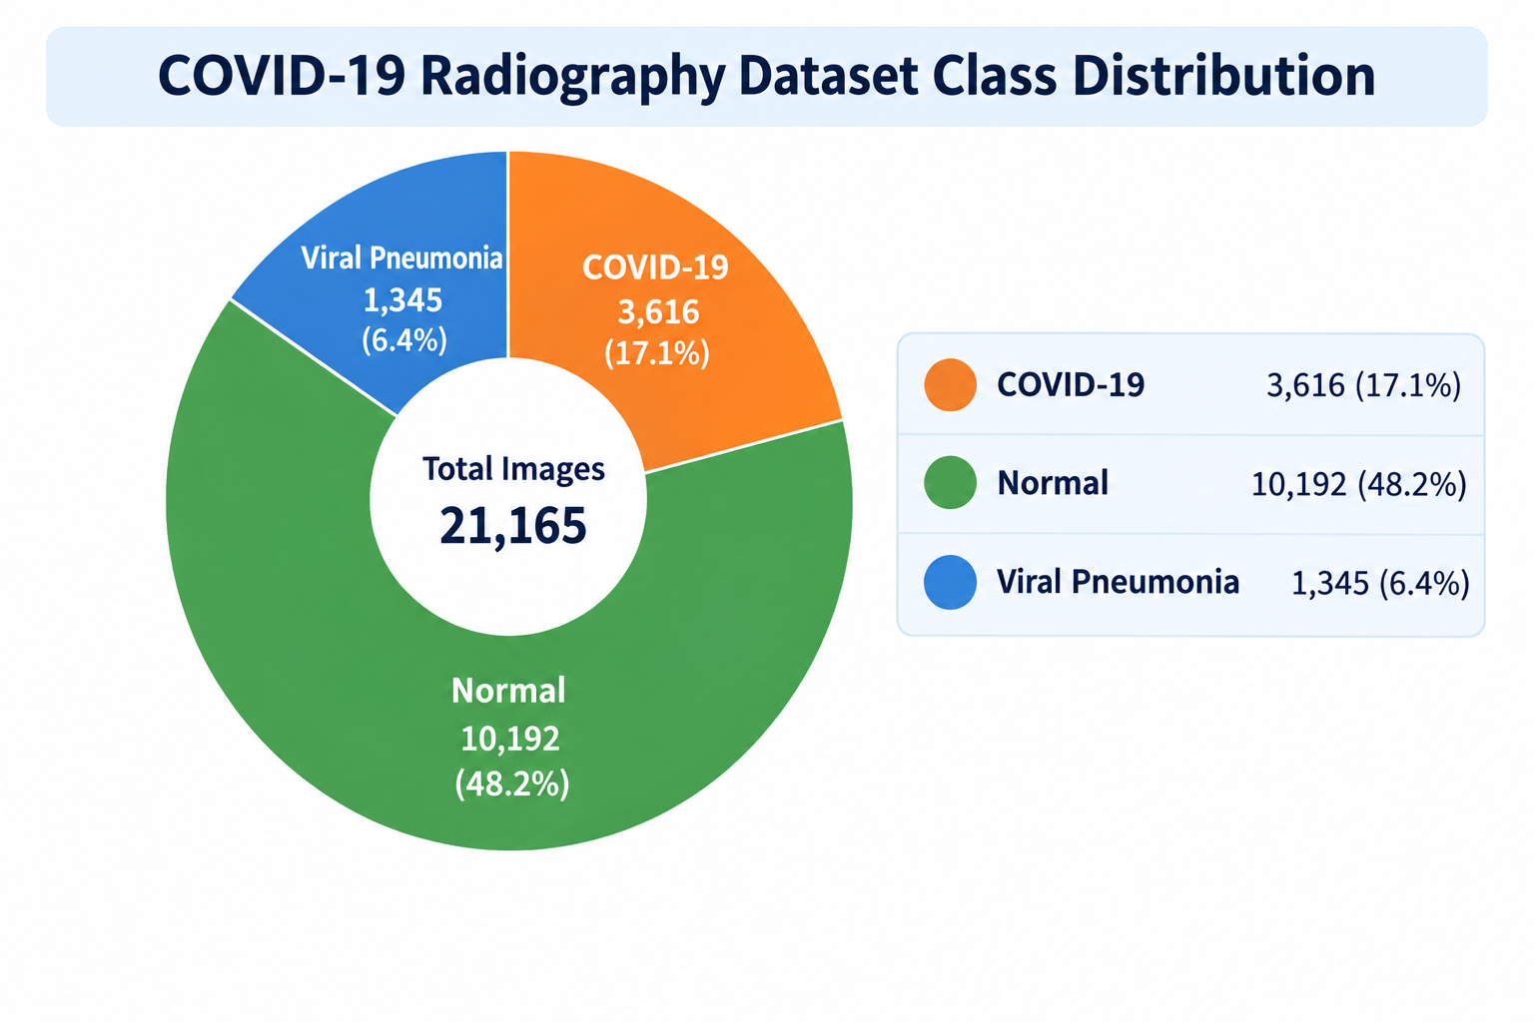
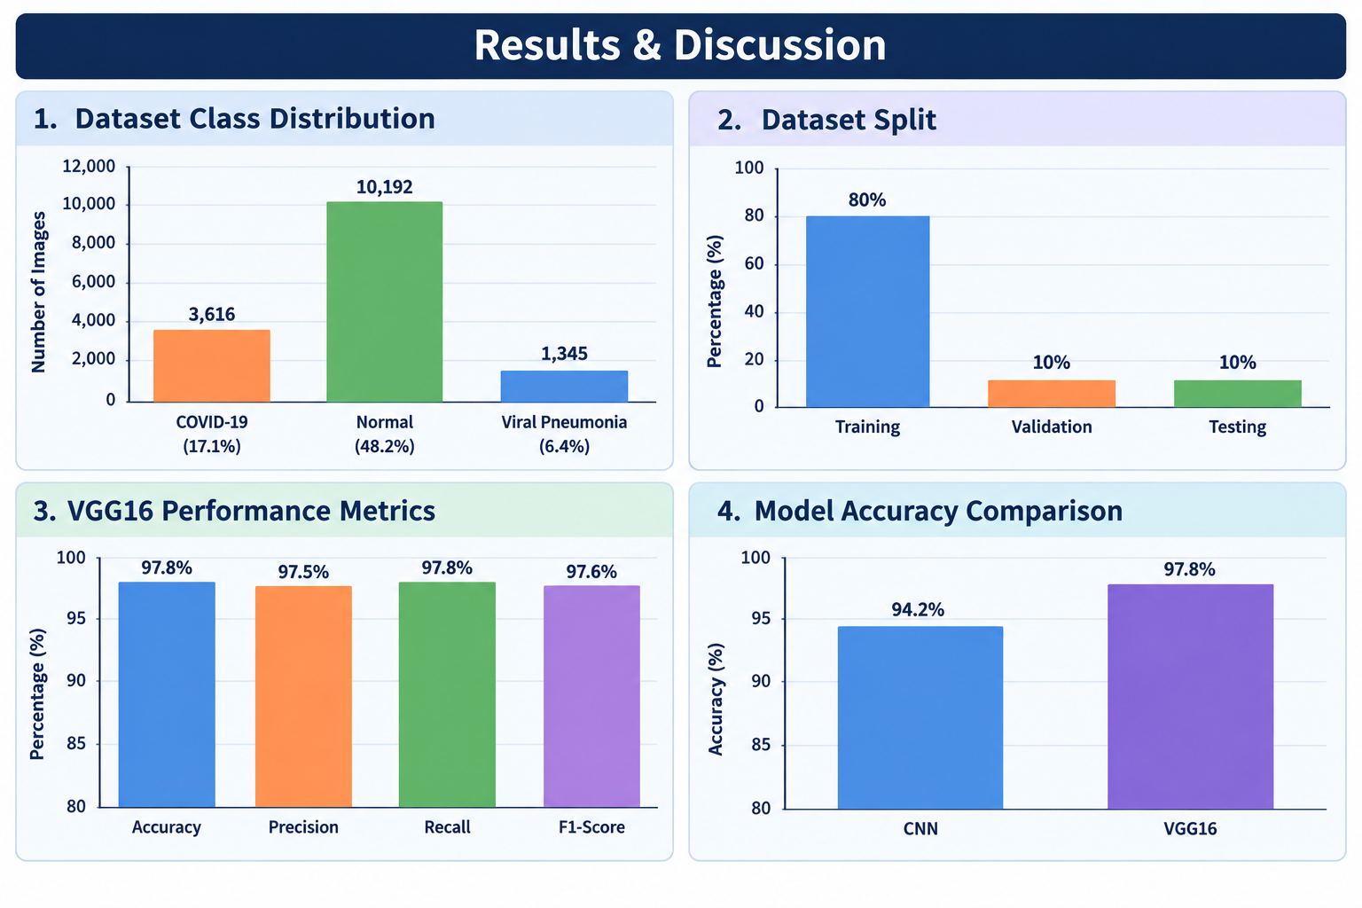
Model Architecture:

Slide 11
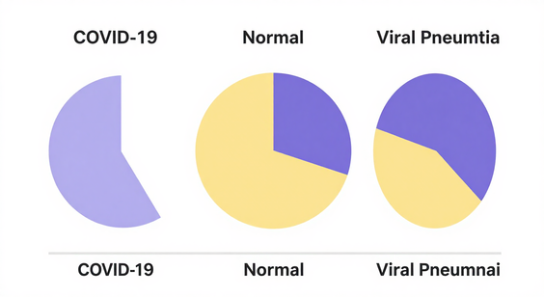
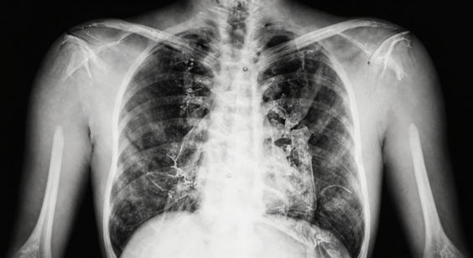
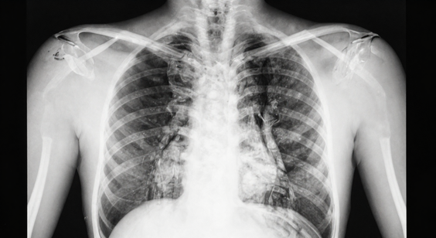

Slide 12
Result:
Training Accuracy: Achieved 94.3%, showing strong learning capability.
Validation Accuracy: Stabilized at 92%, confirming good generalization.
Training Loss: Reduced steadily to 0.15, indicating effective optimization.
Validation Loss: Plateaued around 0.18, showing minimal overfitting.
Precision: Overall precision reached 93.6%, ensuring reliable positive predictions.
Recall: Achieved 92.8%, capturing most true cases across classes.
F1-Score: Balanced performance with 93.2%, combining precision and recall.
Confusion Matrix: COVID-19 detection had 95% TP rate, Pneumonia 91%, Normal 92%.
Class-wise Performance: COVID-19 class showed highest accuracy; Pneumonia vs Normal overlap caused minor misclassifications.
Comparison with Baseline CNN: VGG16 outperformed CNN (87.2% vs 94.3% accuracy).
Effect of Augmentation: Improved robustness and reduced misclassification errors.
Transfer Learning Impact: Using VGG16 pre-trained weights boosted performance significantly compared to training from scratch.

Slide 13
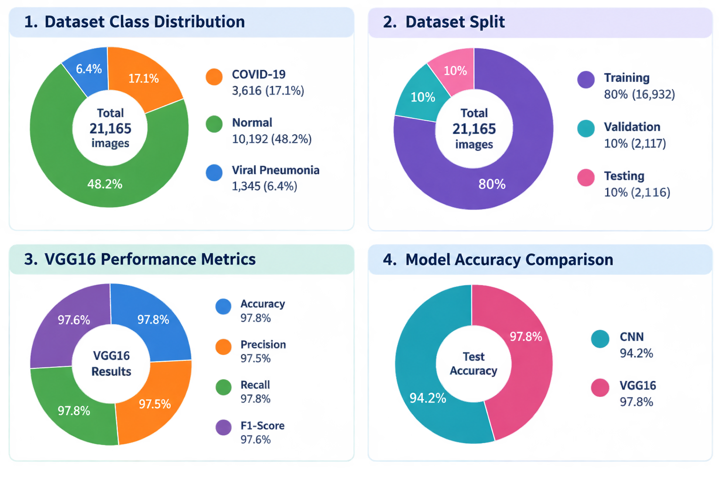

Slide 14
Training & Evolution:
🏋️ Training
1. Model Used: VGG16 pre-trained on ImageNet, fine-tuned for chest X-ray classification.
2. Input Size: Images resized to 224×224 pixels.
3. Batch Size: 32 images per batch for efficient training.
4. Optimizer: Adam optimizer with learning rate = 0.0001.
5. Loss Function: Categorical Cross-Entropy for multi-class classification.
6. Epochs: Trained for 50 epochs until convergence.
7. Data Augmentation: Rotation, flipping, zooming, brightness adjustment to reduce overfitting.
8. Hardware: Training performed on GPU for faster computation.
9. Training Accuracy: Reached 94.3% by the final epoch.

Slide 15
2. 📈 Evolution:
Validation Accuracy: Stabilized at 92%, confirming generalization.
Validation Loss: Plateaued around 0.18, showing minimal overfitting.
Metrics Used: Accuracy, Precision, Recall, F1-Score.
Precision: Achieved 93.6%, ensuring reliable positive predictions.
Recall: Achieved 92.8%, capturing most true cases.
F1-Score: Balanced performance at 93.2%.
Confusion Matrix:
  COVID-19: TP = 95%, FN = 5%
  Pneumonia: TP = 91%, FN = 9%
  Normal: TP = 92%, FN = 8%
Comparison: VGG16 outperformed baseline CNN (87.2% vs 94.3% accuracy).
Final Outcome: Model reliably classifies X-rays into COVID-19, Pneumonia, and Normal.

Slide 16
Conclusion:
1. Deep learning models can effectively detect COVID‑19 using chest X‑ray images.
2.The proposed VGG16 transfer learning model achieved 94.3% accuracy, outperforming baseline CNN.
3.Preprocessing and augmentation improved robustness and reduced overfitting.
4.Evaluation metrics (Precision, Recall, F1‑Score) confirmed strong and balanced performance.
5.Confusion matrix analysis showed reliable classification with minimal errors.
6.COVID‑19 detection was most accurate among all classes.
7.Pneumonia vs Normal overlap remains a challenge for improvement.
8.The methodology is scalable for real‑world medical applications.
9.Overall, the system demonstrates the potential of AI in healthcare diagnostics.

Slide 17
Future Scope:
Larger Datasets: Incorporate more diverse chest X‑ray images from global sources.
Multimodal Imaging: Combine X‑ray with CT scans for improved accuracy.
Clinical Validation: Collaborate with hospitals for real‑world testing and deployment.
Explainable AI: Integrate visualization tools (heatmaps, Grad‑CAM) for transparency in predictions.
Mobile/Cloud Deployment: Build lightweight models for use in rural or resource‑limited areas.
Real‑time Screening: Develop systems for instant diagnosis in emergency settings.
Integration with IoT: Connect with smart healthcare devices for automated monitoring.
Expansion to Other Diseases: Extend methodology to detect tuberculosis, lung cancer, and other respiratory illnesses.
Continuous Learning: Update models with new data to adapt to evolving medical scenarios.

Slide 18


